Slide 1
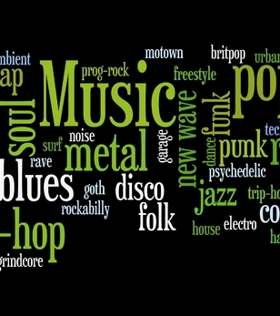

M.U.G.G.E. Mostly Unfinished Genre Grading Engine
As a project of the class Machine Learning at the University of Hamburg

Slide 2
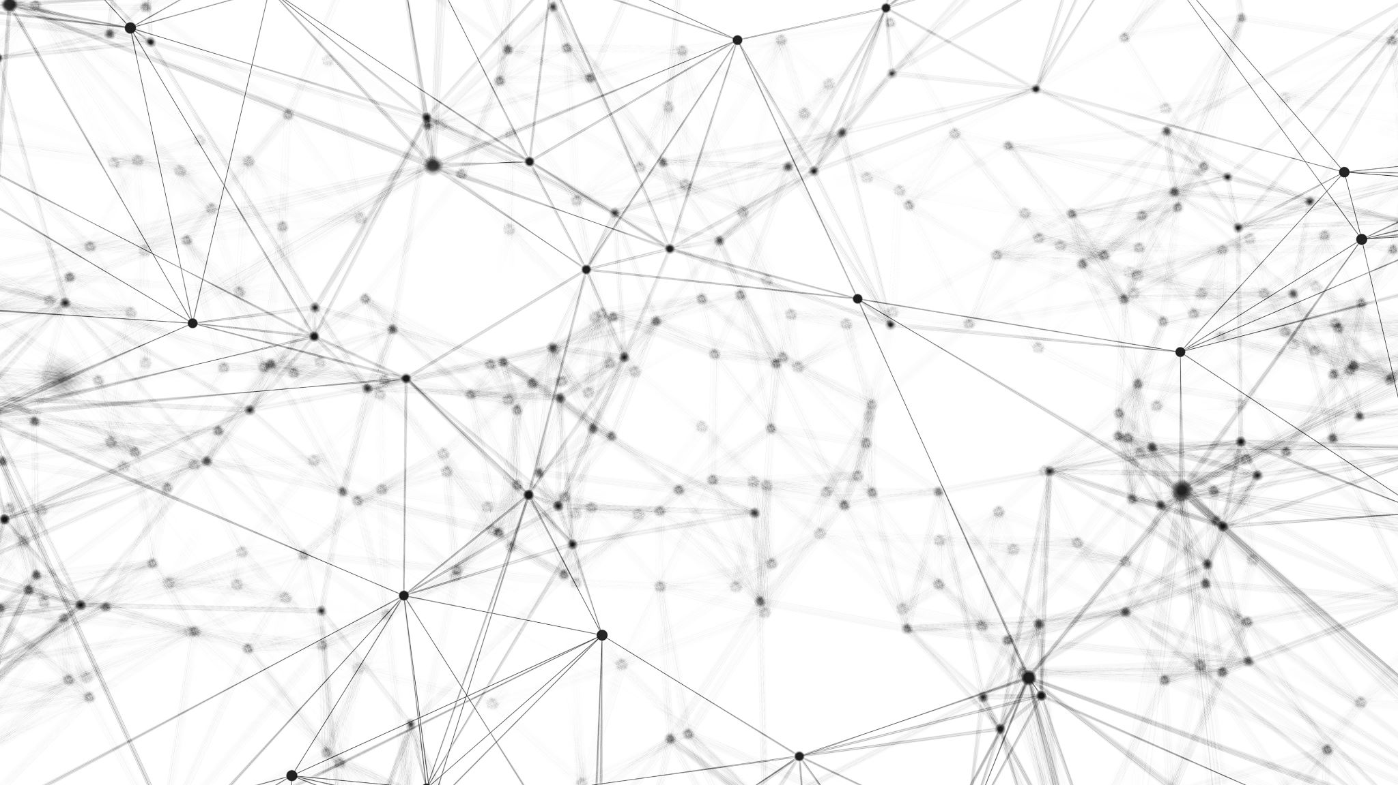
Goals
Build a high performance model for basic learners
Use a balanced medium size dataset to classify 10 genres
Investigate different classifiers finding the most efficient one for classifying our genres
High performance predictions recording new input
Build a model capable of efficient predictions given new input
Build a GUI

Slide 3
Music Genres
Blues
Classical
Country
Disco
Hip Hop
Jazz
Metal
Pop
Reggae
Rock

Slide 4
Dataset
1000 songs
100 songs for each genre
Audio duration: 30 seconds
Source of dataset: Kaggle.com, GTZAN Dataset-Music Genre Classification

Slide 5
Features
Zero Crossing rate
Spectral Centroid
Mel-Frequency Cepstral Coefficients
Chroma Frequencies
Chords

Slide 6
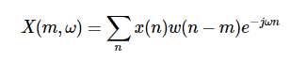
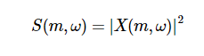
Short-Time Fourier Transform
Music signals are highly non-stationary, i.e., their statistics change over time.
Meaningless to compute a single FT over an entire song
The STFT is obtained by computing the Fourier transform for successive frames in a signal:
Time m and frequency w
Since we care about the spectral magnitude and not the phase content, we use the spectrogram, which shows the intensity of frequencies over time.
A Spectogram is simply the squared magnitude of the STFT:

Slide 7
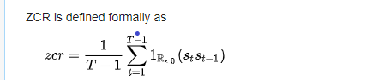
Zero Crossing Rate
The number of times the amplitude of the signal passes through a value of zero, within a time interval.
Measure of smoothness of an audio signal
Higher values for highly percussive sounds like those in metal and pop.
where s: signal of length T

Slide 8
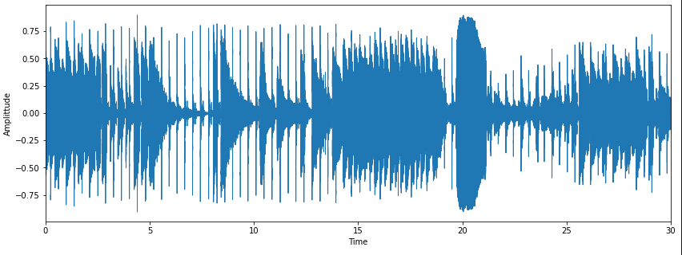
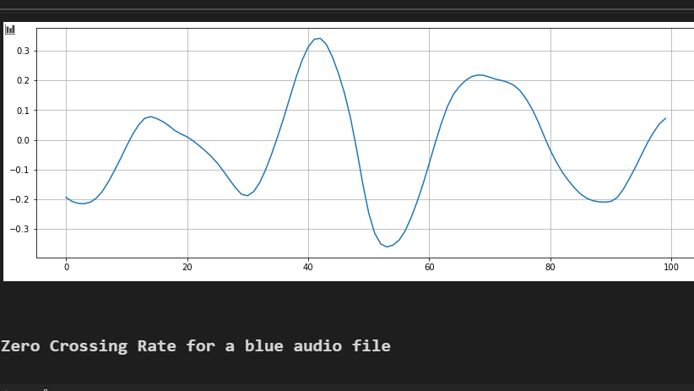
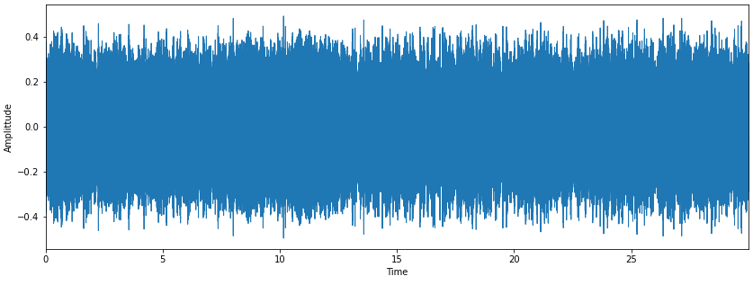
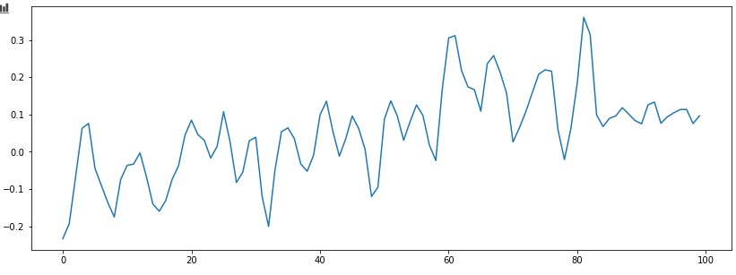
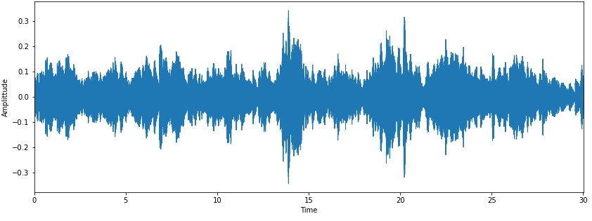
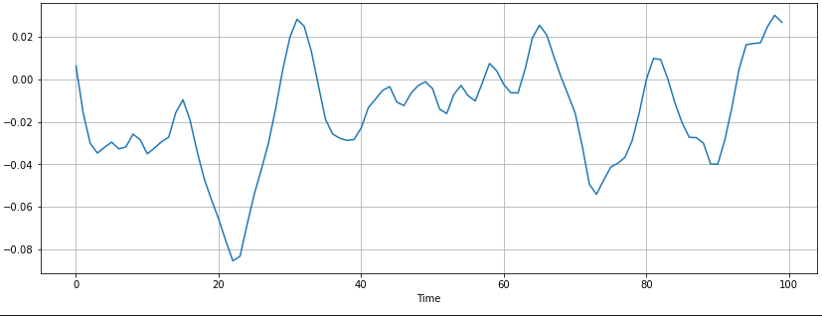
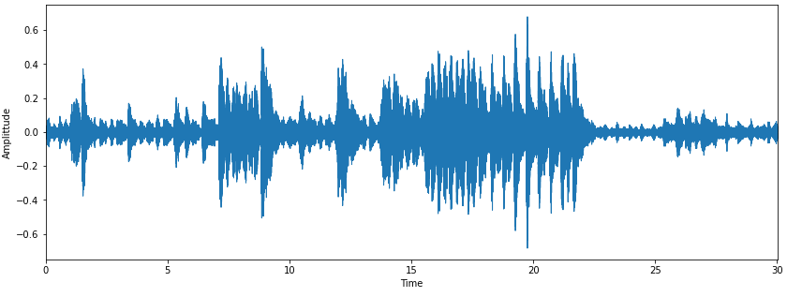
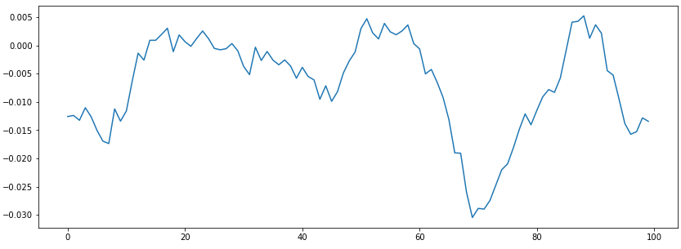
Blues Zero Crossings: 7
Metal Zero Crossings: 19
Classical Zero Crossings: 10
Jazz Zero Crossings: 12

Slide 9
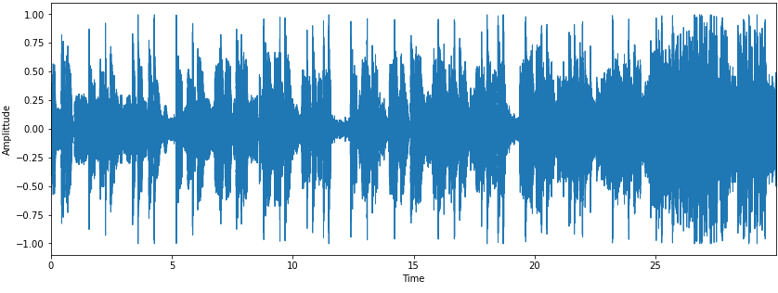
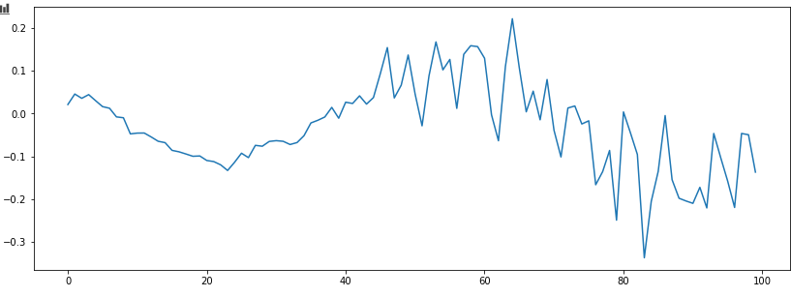
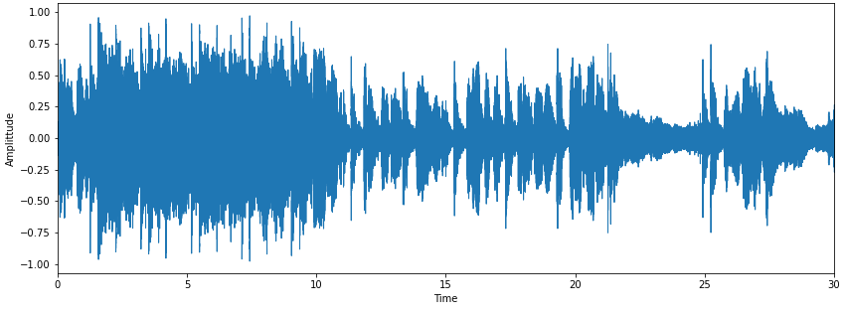
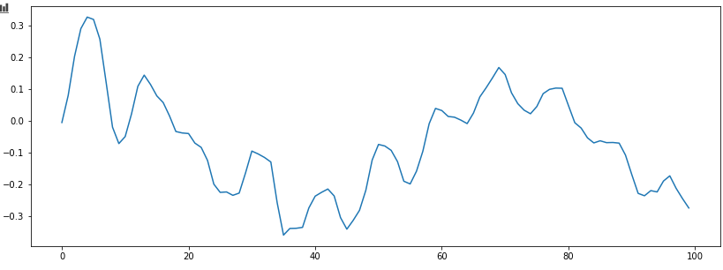
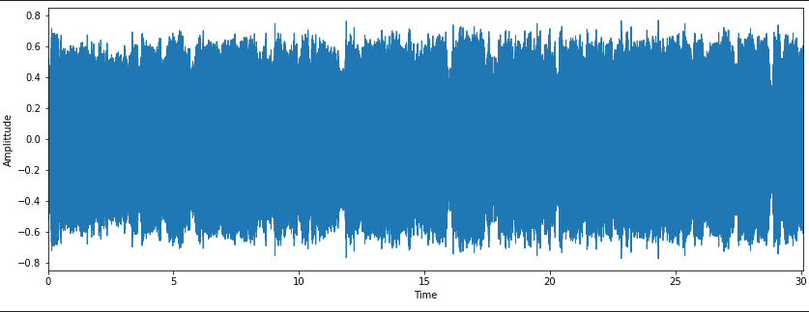
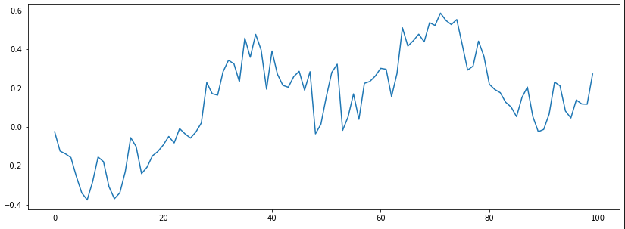
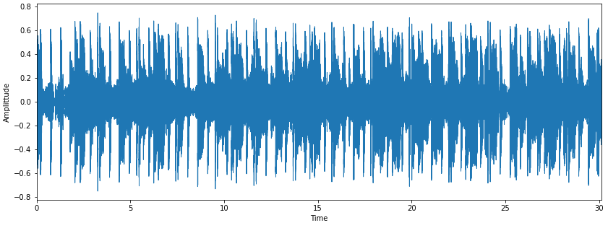
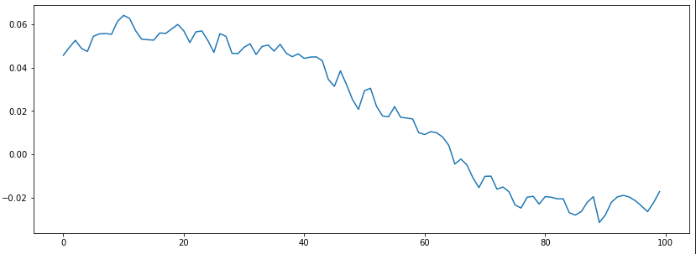
Pop Zero Crossings: 15
Rock Zero Crossings :8
Country Zero Crossings :7
Disco Zero Crossings : 1

Slide 10
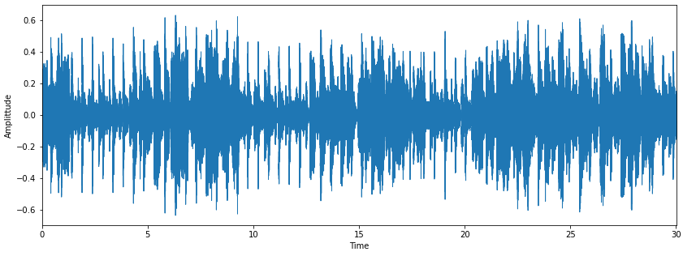
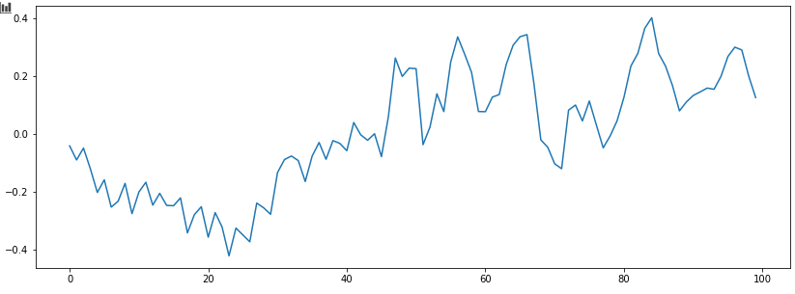
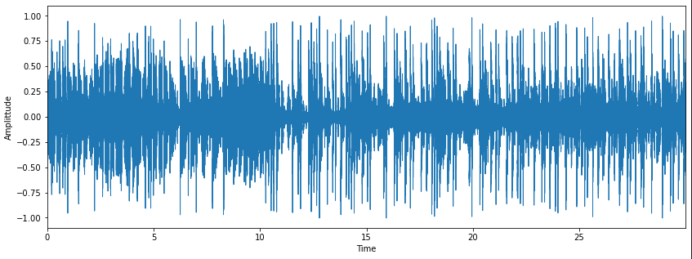
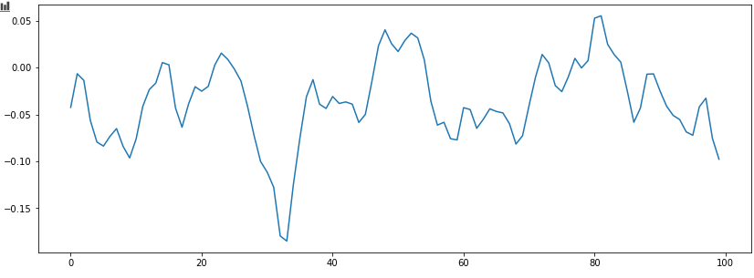
Reggae Zero Crossings:11
Hip Hop Zero Crossings: 12

Slide 11
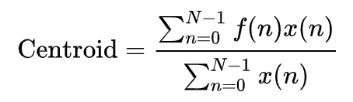
Spectral Centroid
Measure used to characterise a spectrum
Indicates where the „centre of the mass“ for a sound is located
Calculated as the weighted mean of the frequencies present in the sound
x(n) represents the magnitude, f(n) the mean frequency of every interval

Slide 12
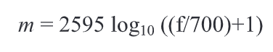
MFCC
Small set of features (20 in our case)
Describe the overall shape of a spectral envelope and models the charasteristics of the human voice
Human perception of speech/sound is linear until 1000 Hz Range(100-3200 Hz) and logarithmic from threre
Conversion from normal frequency f to mel frequency m:

Slide 13
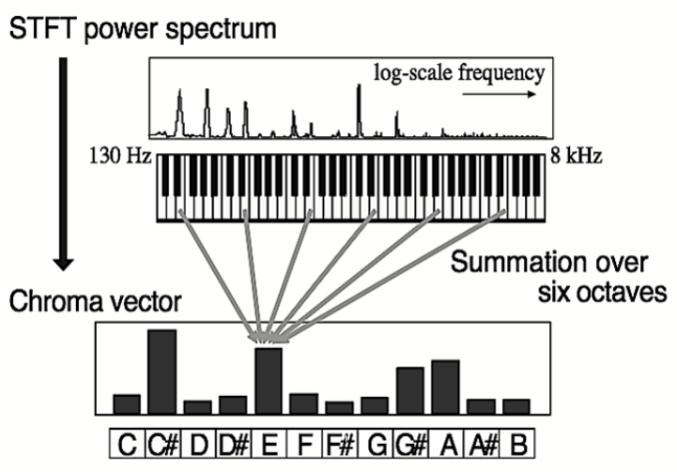
Chroma
Project the whole spectrum onto the 12 distinct semitones (chromas) of the musical octave
Mellina, Alessio & Sentinelli, Alexandro & Marfia, Gustavo & Roccetti, Marco. (2012). AREEB: Automatic REfrain extraction for ThumBnail. 2012 IEEE Consumer Communications and Networking Conference, CCNC'2012. 10.1109/CCNC.2012.6181003.

Slide 14
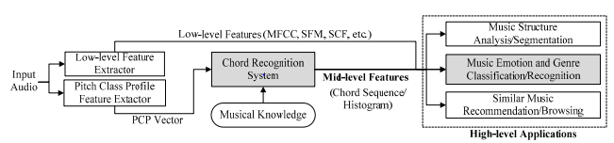
Chord Feature
Taking the Chromagramm and extract the Pitch Class Profile
Calculate the Transition Matrix
Train the Neural Network

Slide 15
Chord Feature
Chromagram on one Side, Transition Matrix on the other Side
Prob 2 different songs

Slide 16
Our Classifiers
Logistic Regression:
“One-versus-rest“ scheme, uses a quasi-Newton optimizer with a maximum of 100 iterations
Random Forests:
Averages over multiple Decision Trees, which are only trained on subsets of the available data
Multi-Layer Perceptron:
Supervised Neural Network with tunable size of hidden layers
Uses Backpropagation, and stochastic gradient descent or a quasi-Newton optimizer
Support Vector Machine:
Parameters: c.f. Appendix

Slide 17
Model Selection: MLP
Which Parameters form the model with the highest accuracy? Investigated options included:
hidden_layer_sizes: (100) , (100,50) or (50,50,50)
activation: ‘relu‘ or ‘logistic‘
solver: ‘lbfgs’ (quasi-Newton optimizer) or ’adam’ (based on stochastic gradient descent)
alpha: 0.0001 or 0.01
learning_rate: ‘constant‘, ‘invscaling’ or ‘adaptive’
max_iter: 250 or 500
→ Find the best parameters with a cross-validated grid-search over this parameter grid

Slide 18
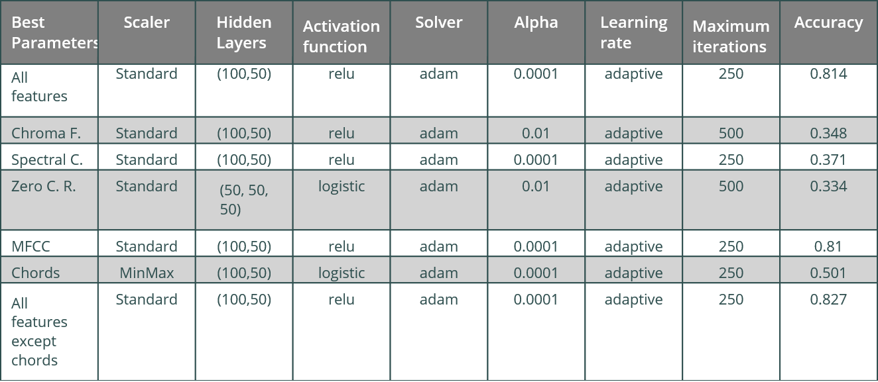
Parameters with highest accuracy

Slide 19
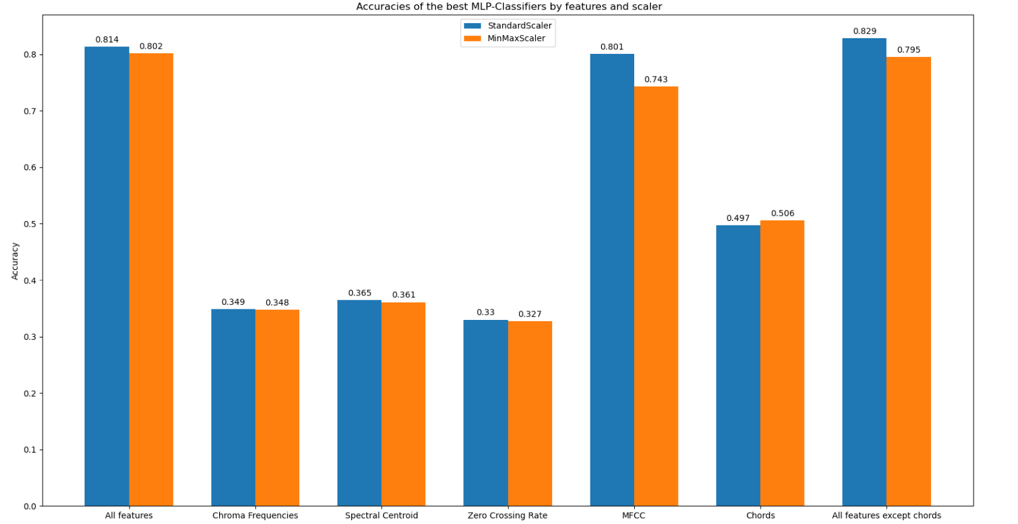
Parameters with highest accuracy

Slide 20
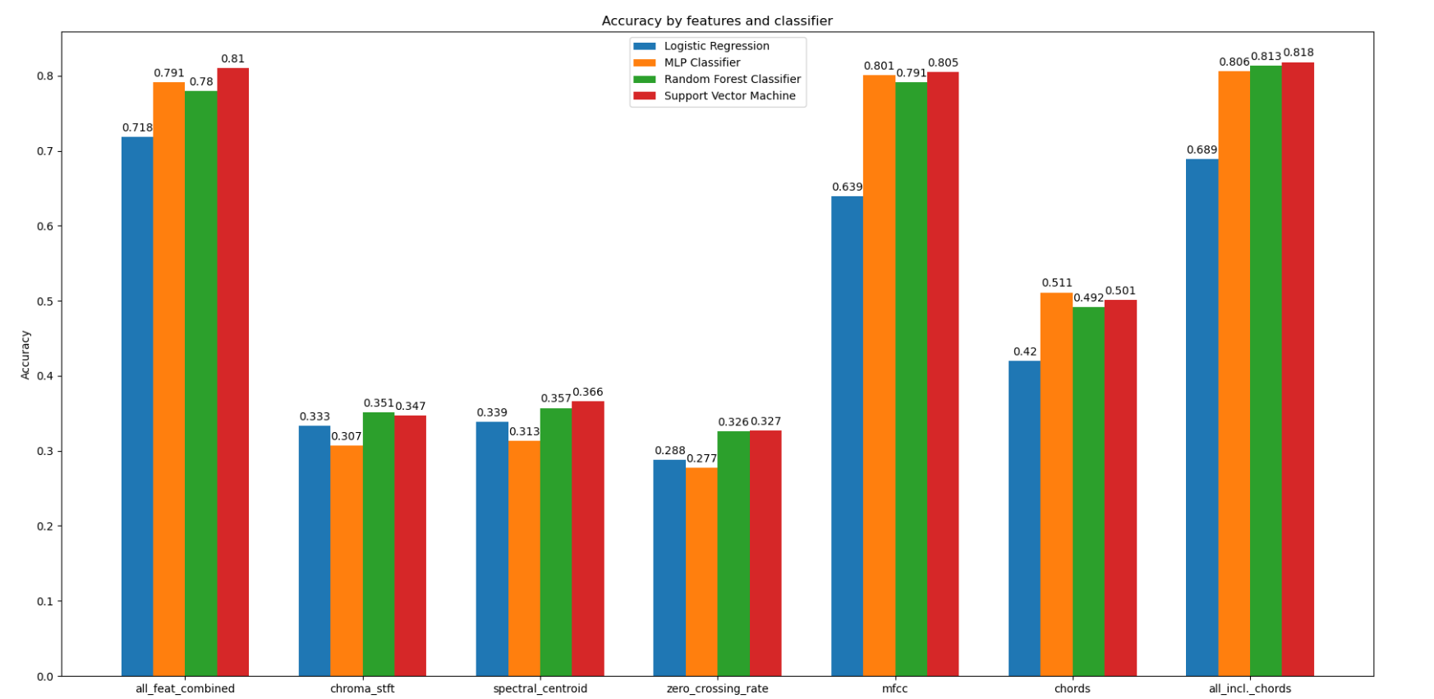
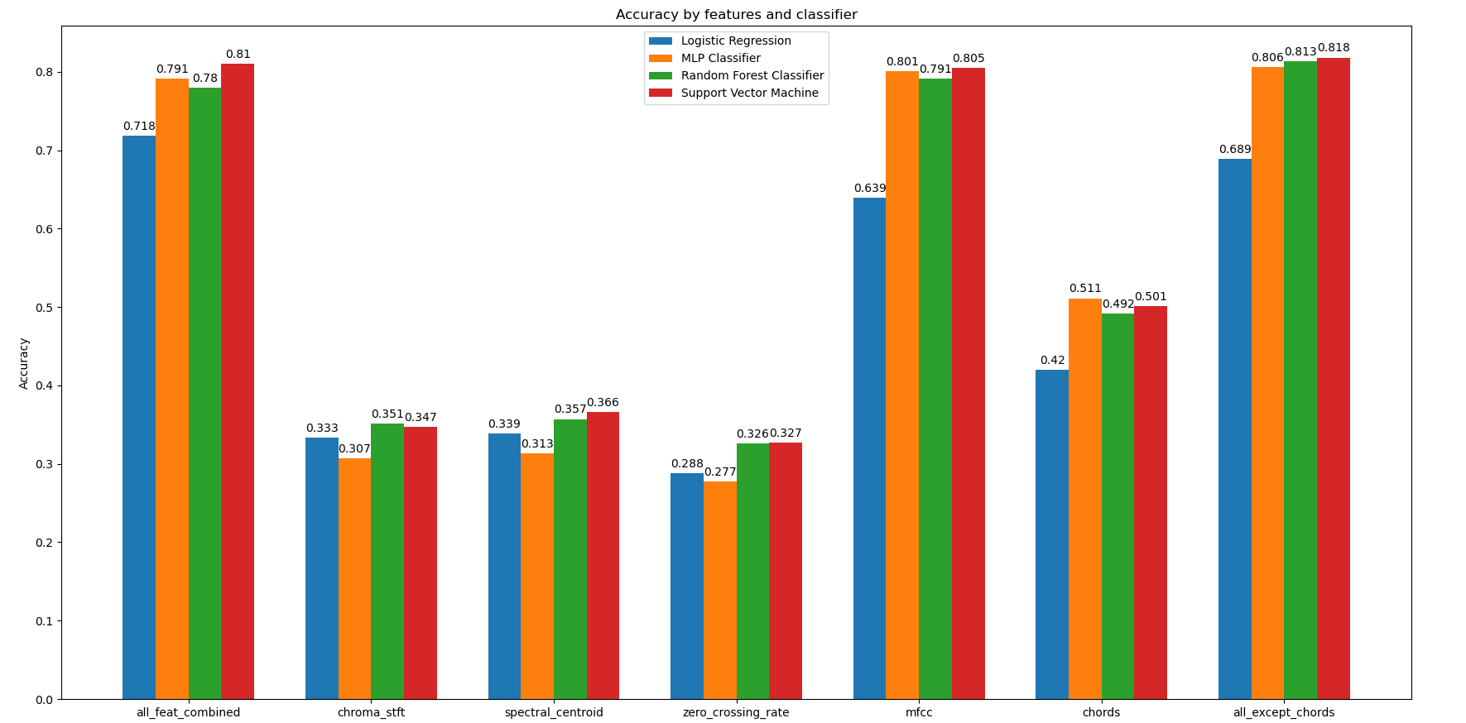
Evaluation: Accuracies

Slide 21
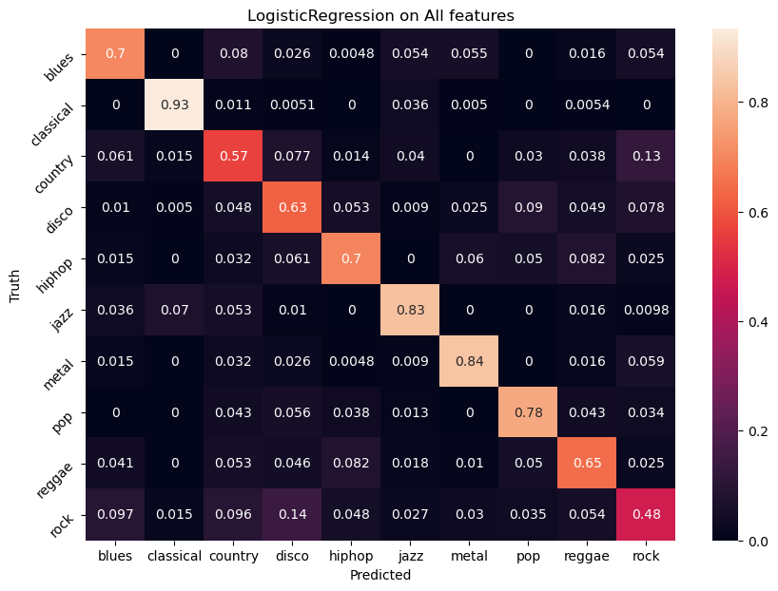
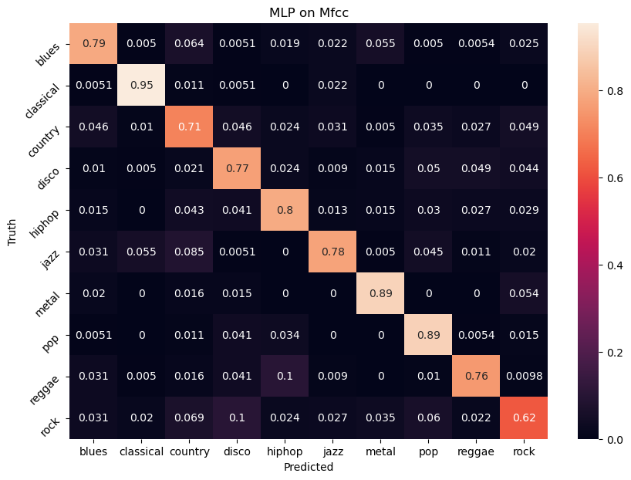
Confusion Matrizes

Slide 22
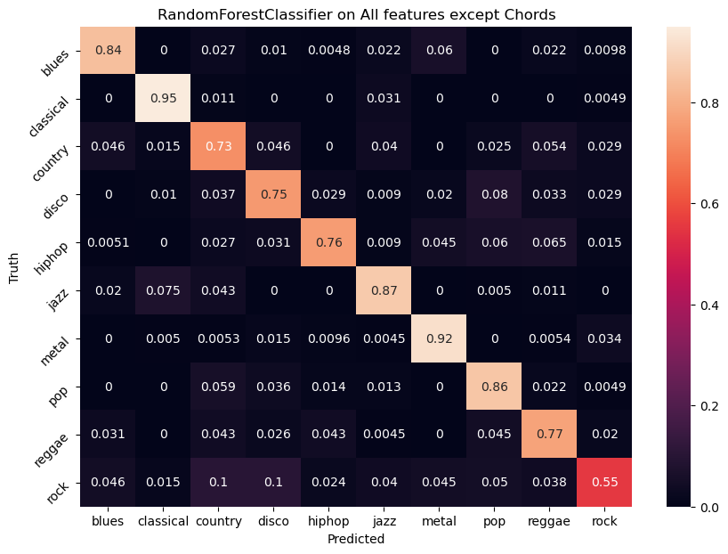
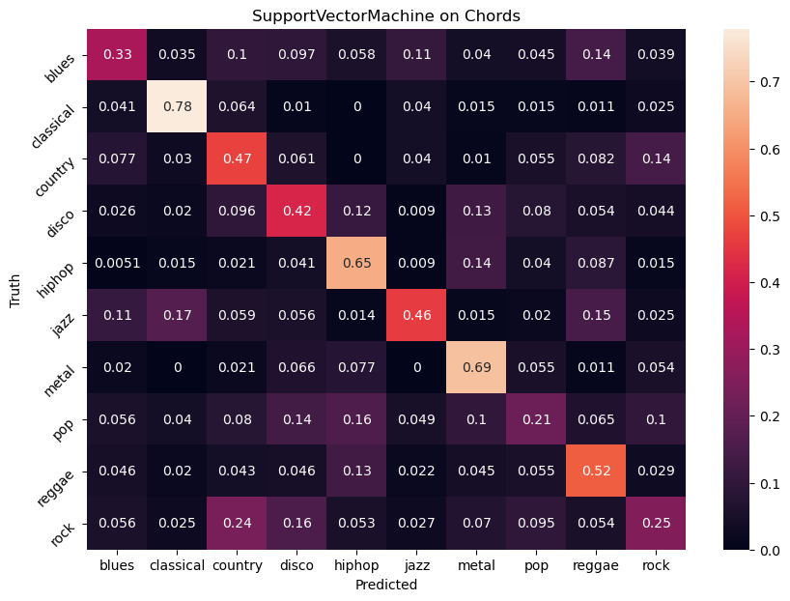
Confusion Matrizes

Slide 23
Florians
Test

Slide 24
Input-Pipeline
Job:
input costum data to be classified.
arrange data to be accessible for the feature- and model boxes
Approach:
team needs 1-D numpy arrays of audio-samples, due to Librosa-specification
therefore, develop routine to read/record audio-files and convert these into required numpy arrays
libraries: pydub (requires: FFMPEG), sounddevice

Slide 25
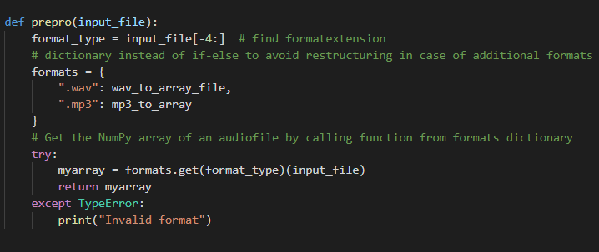
Input-Pipeline
Read & Convert Files:
input: File
master function reads and delegates tasks to appropriate functions
decided for WAV and MP3
use dictionary to make code easily extendable
return: array

Slide 26
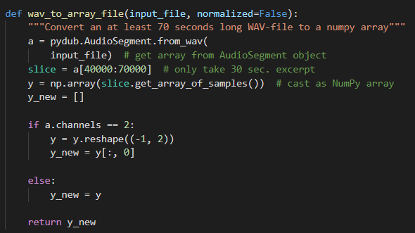
Input-Pipeline
Convert file to array:
input: file
only take 30 seconds of audio , needed for the classifyer
each channel has an independent audio signal, so taking one channel for samples should suffice
return: array

Slide 27
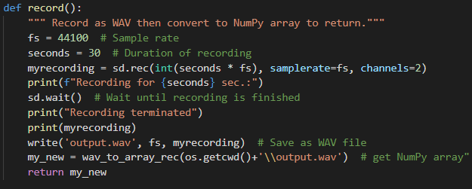
Input-Pipeline
Record:
record for 30 seconds to WAV
technical part outsourced to Sounddevice
convert WAV to array of samples
return: array

Slide 28
Outlook:
Possible next/further steps:
Feature based: extract more features (eg. spectral-rollof), compare standard deviation with variance
Data based: Use 1million songs data set
Model based: scale with sklearn.Normalizer, cross-validated grid-search for all Classifiers
Train a Neural Network with only the images of the Spectrograms
Evaluate effects of different input formats
GUI?

Slide 29
References 1/
https://www.kaggle.com/andradaolteanu/gtzan-dataset-music-genre-classification/data ; free available dataset
https://towardsdatascience.com/music-genre-classification-with-python-c714d032f0d8
Valerio Velardo - The Sound of AI (YouTube Channel)
https://towardsdatascience.com/musical-genre-classification-with-convolutional-neural-networks-ff04f9601a74
MSc Computer Science, University of Birmingham,‘‘Machine Learning for Music Genre Classification‘‘, Author: Bryn Lansdown, Supervisor: Dr. Shan He
https://www.youtube.com/watch?v=t0mNFAFdz_Q&t=267s Caio Miyashiro at Pydata Berlin 2019 about Chord Recognition
Cheng, Heng-Tze & Yang, yi-hsuan & Lin, Yu-Ching & Liao, I-Bin & Chen, Homer. (2008). Automatic chord recognition for music classification and retrieval. 1505 - 1508. 10.1109/ICME.2008.4607732.

Slide 30
References 2/
Mellina, Alessio & Sentinelli, Alexandro & Marfia, Gustavo & Roccetti, Marco. (2012). AREEB: Automatic REfrain extraction for ThumBnail. 2012 IEEE Consumer Communications and Networking Conference, CCNC'2012. 10.1109/CCNC.2012.6181003.
https://musicinformationretrieval.com/stft.html
https://scikit-learn.org/

Slide 31
Task Distribution
All team members: Find literature, papers and investigate different approaches of the problem from multiple, open to the public sources
Dennis: Project Management, merge and control the Project Plan, part of feature extraction especially chord feature
Stella: Find dataset, Explore features needed to be extracted (coll. with Dennis, Joshua), Feature extraction from dataset and store in a csv file (coll. with Joshua), Import confusion matrices(coll. with Florian)
Joshua: Feature Extraction, Model Selection, Model Evaluation
Florian:
Claas:

Slide 32
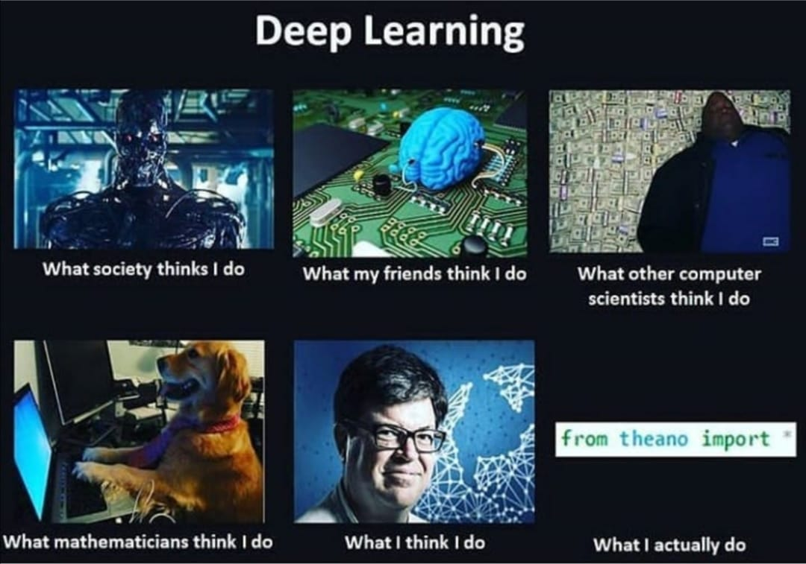


Slide 33
Appendix

Slide 34
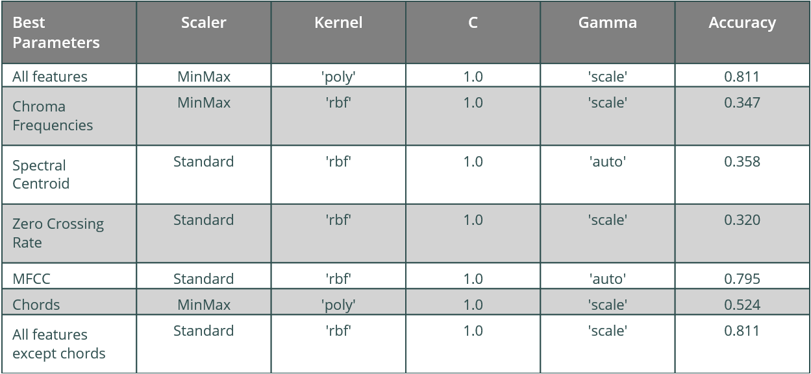
Model Selection: SVM

Slide 35
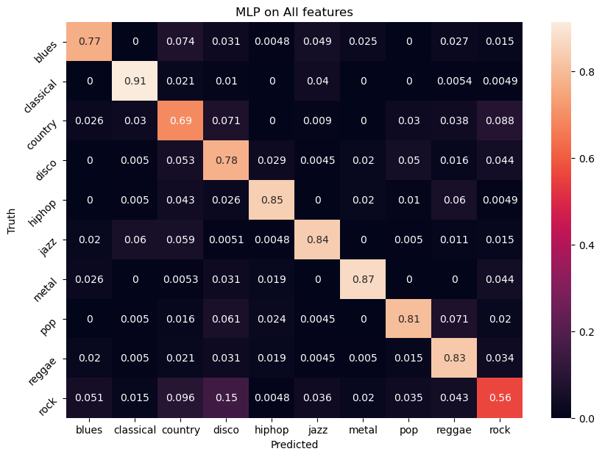
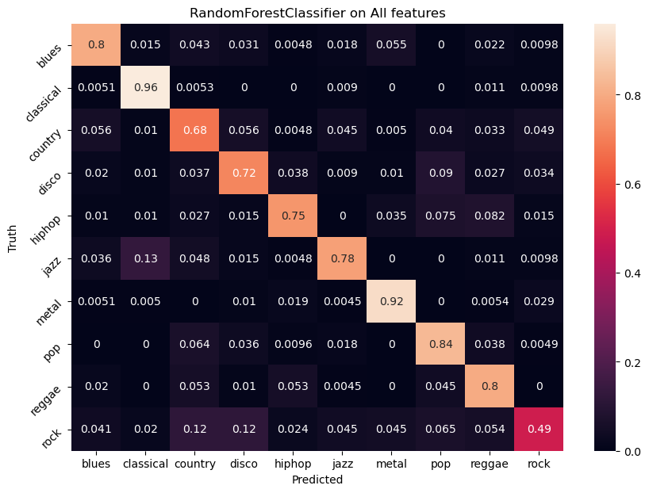
More Confusion Matrizes

Slide 36
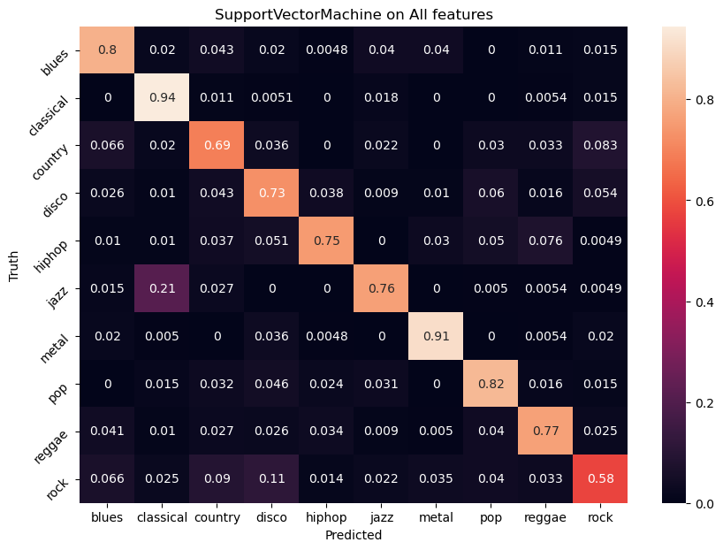

More Confusion Matrizes

Slide 37
Code
You can find the code at:
https://github.com/MrGandalv/MUGGE

